Slide 1
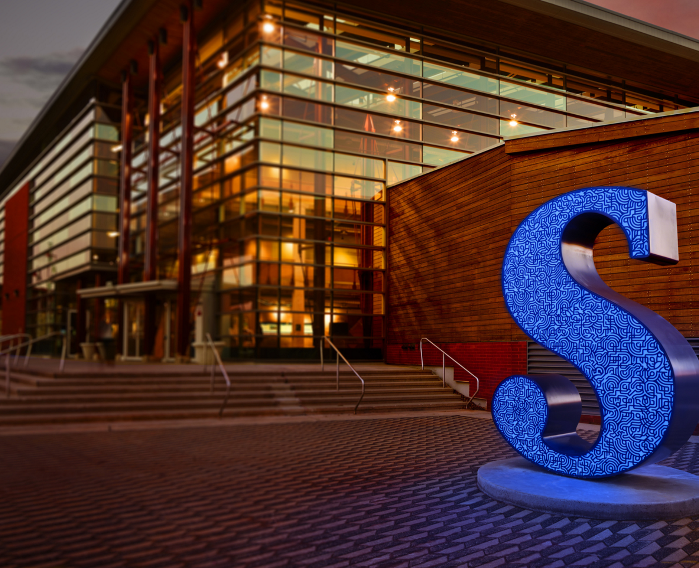
Slate On Hand
Never miss any due dates!
You can get better grades!
by Hyeeun Mok

Slide 2
Agenda
Our Concept
Findings from User Survey
Initial Wireframes
Findings from User Testing
Revised Wireframes
Lessons Learned

Slide 3
Our Concept
What is it?
- The Slate on Hand mobile application
- Show students timetables, due dates and school email all in one place
- Save a lot of time for students by reducing the amount of clicking and searching on the Slate website
- Make sure students do not miss any due dates
Target User Audience
- Sheridan Students

Slide 4
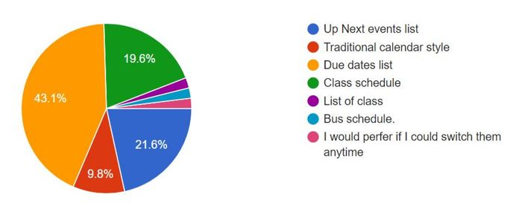
Findings from User Survey
Top ranked features
- Group chat feature
- Notifications
Lowest ranked features
- Personal Alerts
- Main Layout (Up Next)
Features not considered
- Carpool alerts/notifications
- Bus schedule

Slide 5
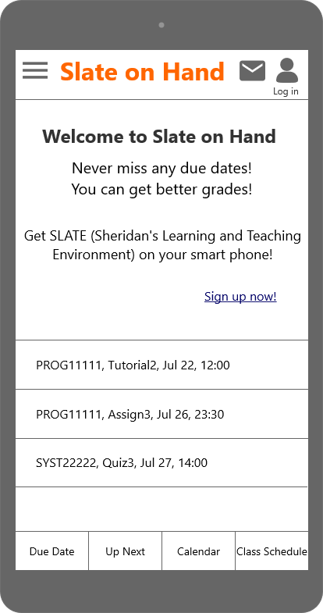
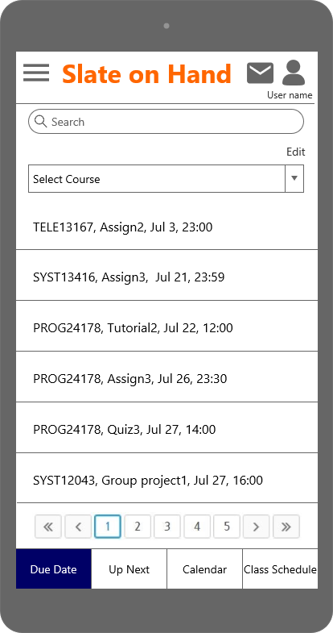
Initial Wireframes (1) – Landing & Main pages

Slide 6
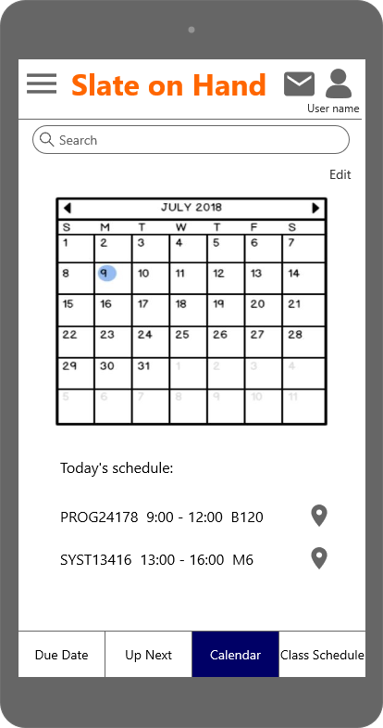
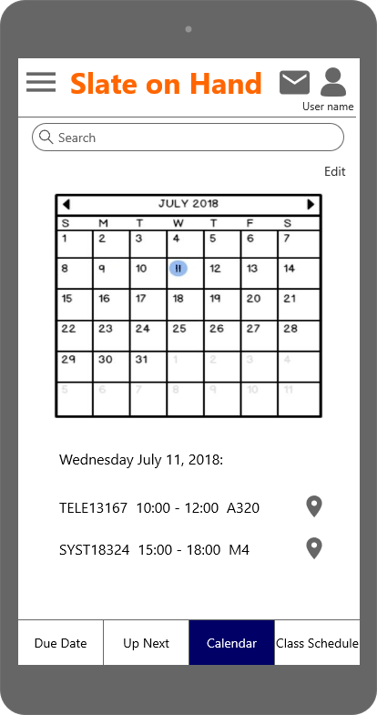
Initial Wireframes (2) – Calendar

Slide 7
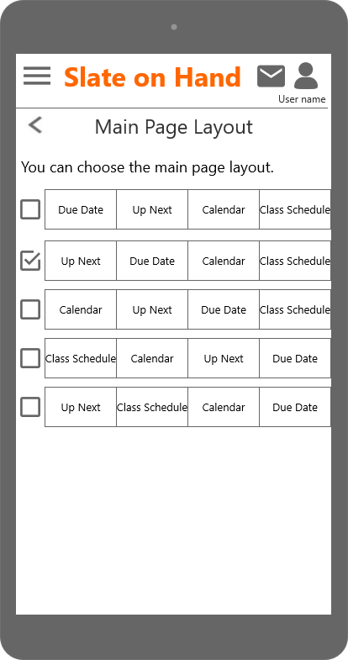
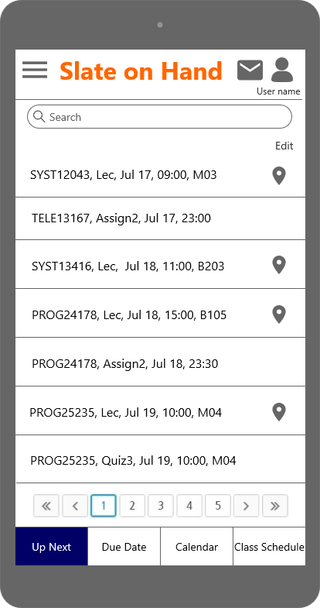
Initial Wireframes (3) – Changing main layout

Slide 8
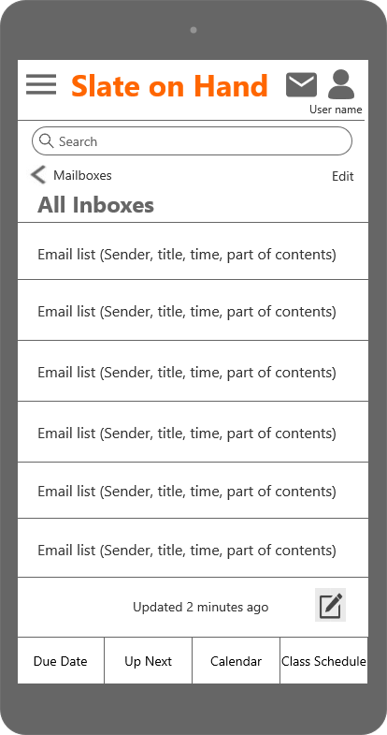
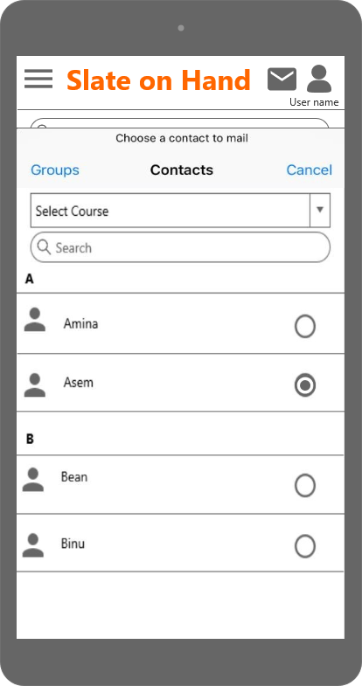
Initial Wireframes (4) – Email

Slide 9
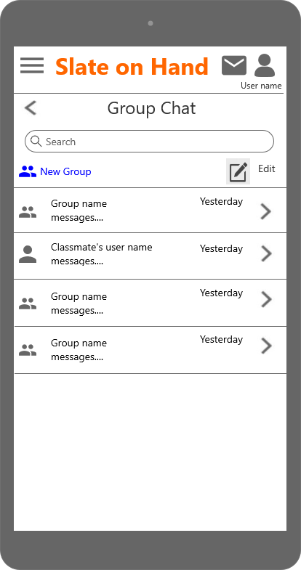
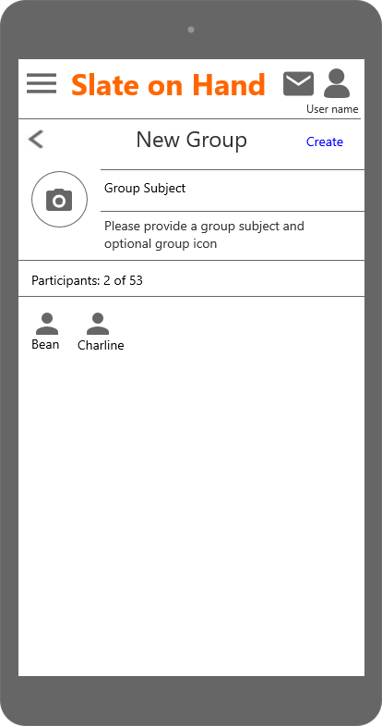
Initial Wireframes (5) – Group chat

Slide 10
Findings from User Testing (1)
What went well
- Log in/out
- Checking the calendar
What didn’t go well
- Creating a group chat room
- Creating email
- Changing main page layout

Slide 11
Findings from User Testing (2)
Positive feedback
- Easy to use
- Useful for Sheridan students
Negative feedback
- Some buttons and functions are hard to find
Surprise findings
- One user suggested “Drag & Drop” method

Slide 12
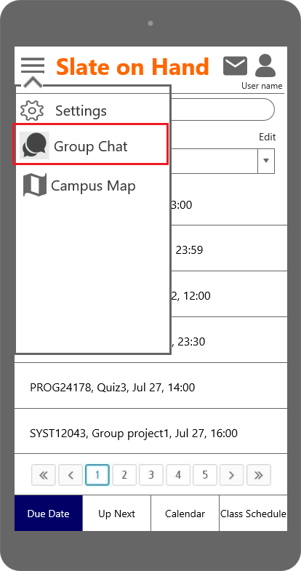
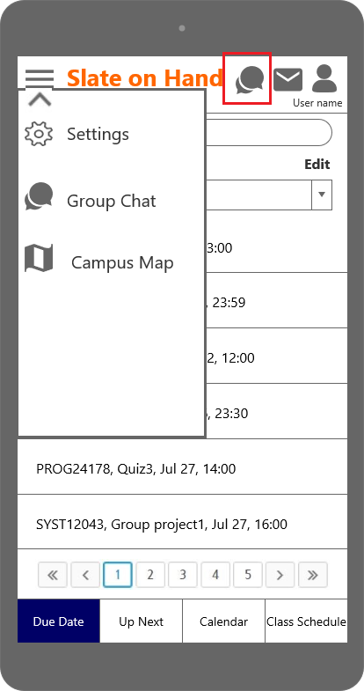
Revised Wireframes (1) - Group Chat Icon
Initial wireframes
Revised wireframes

Slide 13
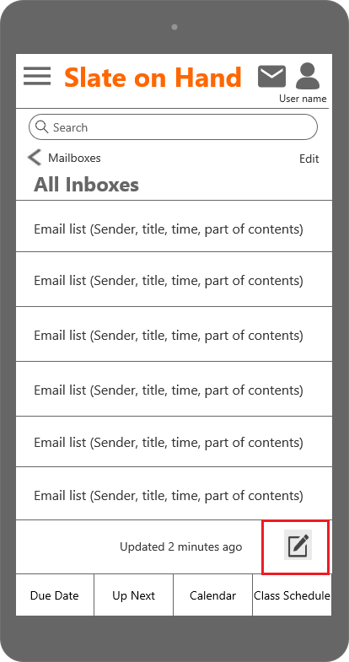
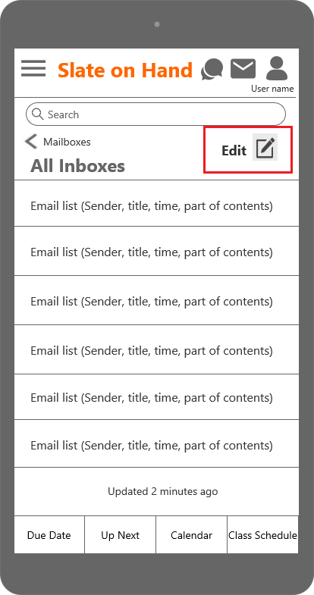
Revised Wireframes (2) – Create a new email Icon & Edit Button
Initial wireframes
Revised wireframes

Slide 14
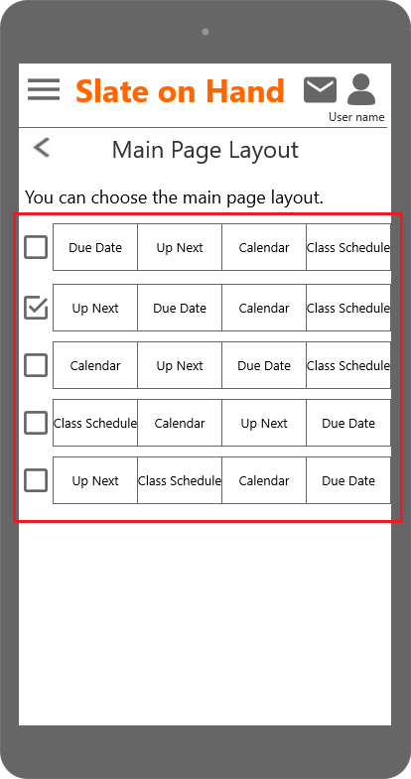
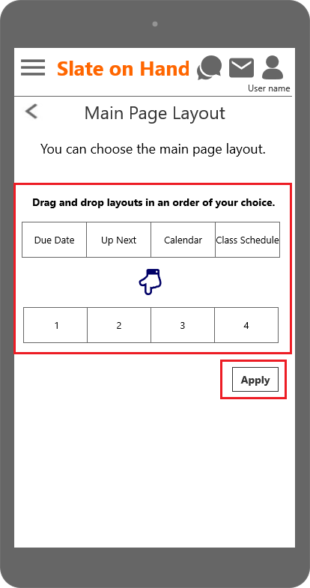
Revised Wireframes (3) - Customizing layout method
Initial wireframes
Revised wireframes

Slide 15
Lessons Learned
Even though it is obvious for us, it is not always obvious for users
We can get great ideas from user testing
User testing is very important
- It makes our app user friendly
The position of icons is crucial for accessibility

Slide 16

Q & A

